Slide 2

Data manipulation with dplyr (aka tidyverse)

Slide 3
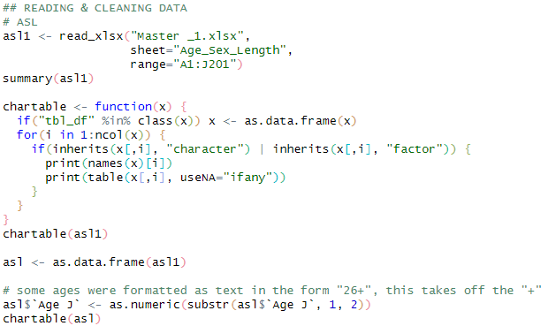
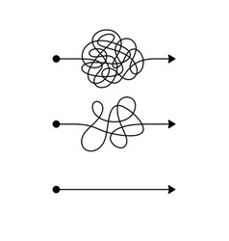
Motivation: Matt’s typical Base R data workflow…
Import MyDataFrame
MyDataFrame1
MyDataFrame2
MyDataFrame3
MyDataFrame4

Slide 4
Motivation: Matt’s typical Base R data workflow…
Import MyDataFrame
Baked-from-scratch syntax
Probably difficult to read for anybody other than Matt (who wrote it)
Which probably includes next-year Matt!
Requires Matt to re-create the syntax correctly every time
Has he had coffee yet?
MyDataFrame1
MyDataFrame2
MyDataFrame3
MyDataFrame4

Slide 5
Motivation: Matt’s typical Base R data workflow…
Import MyDataFrame
Create incremental data.frames?
This creates workspace clutter
Is Matt using the right one?
Or overwrite the original data.frame with every step?
SCARY!!!
MyDataFrame1
MyDataFrame2
MyDataFrame3
MyDataFrame4

Slide 6
But first, introducing the pipe operator %>%
Rule: the %>% moves the
LHS object
to the first position of the
RHS function
x %>% function1
- Is evaluated as -
function1(x)
x %>% function1(someArgs1)
- Is evaluated as -
function1(x, someArgs1)

Slide 7
But first, introducing the pipe operator %>%
Rule: the %>% moves the
LHS object
to the first position of the
RHS function
Conversely, a piped statement begins with an object, and takes a function as its second operand
function1(x)
- becomes -
x %>% function1
x %>% function1
- is evaluated as -
function1(x)
Mental model:
What you started with
What happens to it
x %>% function1(someArgs1)
function1(x, someArgs1)
- is evaluated as -
- becomes -
function1(x, someArgs1)
x %>% function1(someArgs1)

Slide 8
Where this matters: if you have a sequence of operations
function3(function2(function1(x, someArgs1), someArgs2), someArgs3)
Or equivalently
function3(
function2(
function1(x, someArgs1),
someArgs2),
someArgs3)
x %>%
function1(someArgs1) %>%
function2(someArgs2) %>%
function3(someArgs3)
Can be rewritten as

Slide 9
Where this matters: if you have a sequence of operations
function3(function2(function1(x, someArgs1), someArgs2), someArgs3)
What you started with
Or equivalently
What happens to it
function3(
function2(
function1(x, someArgs1),
someArgs2),
someArgs3)
x %>%
function1(someArgs1) %>%
function2(someArgs2) %>%
function3(someArgs3)
Then what happens to that
Can be rewritten as
Then what happens to that…

Slide 10

The dplyr package
Provides a set of functions (“verbs”) for typical data operations
All of these take a data.frame as their first argument, and return a data.frame
This means you can %>% a whole sequence in one pipeline!!
myDataFrame %>%
dataVerb1(someArgs1) %>%
dataVerb2(someArgs2) %>%
dataVerb3(someArgs3)

Slide 11
Motivation: Matt’s typical Base R data workflow…
Import MyDataFrame
%>%
dataVerb1(someArgs1)
%>%
MyDataFrame1
dataVerb2(someArgs2)
%>%
MyDataFrame2
dataVerb3(someArgs3)
%>%
MyDataFrame3
dataVerb4(someArgs4)
MyDataFrame4

Slide 12
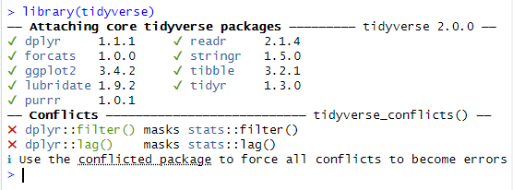
What is the Tidyverse?
The Tidyverse is a collection of packages that extend the usefulness of R, use slightly different language syntax, and play well together
I usually just load the tidyverse package (I’m lazy)
These are all the packages that get loaded at once
Letting you know that there are functions with these names in multiple packages

Slide 13
First, some fake data…
catchdata <- data.frame(station = c(1, 1, 2, 2, 3, 3),
catch = c(12, 23, 44, 65, 34, 49),
hours = c(1, 2, 2, 3, 1, 1.5),
weather = c("sun", "sun", "rain", "rain", "rain", "flood"))
catchdata
station catch hours weather
1 1 12 1.0 sun
2 1 23 2.0 sun
3 2 44 2.0 rain
4 2 65 3.0 rain
5 3 34 1.0 rain
6 3 49 1.5 flood

Slide 14
select(): only keep a subset of columns
catchdata
station catch hours weather
1 1 12 1.0 sun
2 1 23 2.0 sun
3 2 44 2.0 rain
4 2 65 3.0 rain
5 3 34 1.0 rain
6 3 49 1.5 flood
Note: in dplyr syntax, you no longer need the $, since the function already knows to look inside the data.frame you use with it
catchdata %>% select(station, catch)
station catch
1 1 12
2 1 23
3 2 44
4 2 65
5 3 34
6 3 49
Is there a Base R equivalent?
catchdata[ , 1:2]
Not obvious to a reader
Not as robust to changes to the data!
data.frame(station=catchdata$station, catch=catchdata$catch)
Lots of extra typing
catchdata[ , names(catchdata) %in% c("station", "catch")]
Messy!
catchdata %>% select(-hours, -weather)
Same result with negative column names

Slide 15
filter(): only keep a subset of rows
catchdata
station catch hours weather
1 1 12 1.0 sun
2 1 23 2.0 sun
3 2 44 2.0 rain
4 2 65 3.0 rain
5 3 34 1.0 rain
6 3 49 1.5 flood
Any logical vector will be fine here
catchdata %>% filter(station %in% 1:2)
station catch hours weather
1 1 12 1 sun
2 1 23 2 sun
3 2 44 2 rain
4 2 65 3 rain
Is there a Base R equivalent?
catchdata[ catchdata$station %in% 1:2, ]
A little extra typing
A reader might not know what the square brackets mean

Slide 16
mutate(): make (or transform) columns
catchdata
station catch hours weather
1 1 12 1.0 sun
2 1 23 2.0 sun
3 2 44 2.0 rain
4 2 65 3.0 rain
5 3 34 1.0 rain
6 3 49 1.5 flood
Rule: ColName = Formula…
catchdata %>% mutate(catch_rate = catch/hours)
station catch hours weather catch_rate
1 1 12 1.0 sun 12.00000
2 1 23 2.0 sun 11.50000
3 2 44 2.0 rain 22.00000
4 2 65 3.0 rain 21.66667
5 3 34 1.0 rain 34.00000
6 3 49 1.5 flood 32.66667
Is there a Base R equivalent?
catchdata$catch_rate <- catchdata$catch / catchdata$hours
This one’s actually not so bad

Slide 17
mutate(): make (or transform) columns
catchdata
station catch hours weather
1 1 12 1.0 sun
2 1 23 2.0 sun
3 2 44 2.0 rain
4 2 65 3.0 rain
5 3 34 1.0 rain
6 3 49 1.5 flood
Rule: ColName = Formula…
catchdata %>%
mutate(weather = ifelse(weather=="sun", "SUN!", weather))
station catch hours weather
1 1 12 1.0 SUN!
2 1 23 2.0 SUN!
3 2 44 2.0 rain
4 2 65 3.0 rain
5 3 34 1.0 rain
6 3 49 1.5 flood
Logical
Value if TRUE
Value if FALSE
Is there a Base R equivalent?
catchdata$weather[catchdata$weather==“sun”] <- “SUN!”
This one’s actually not so bad

Slide 18
rename(): rename columns
catchdata
station catch hours weather
1 1 12 1.0 sun
2 1 23 2.0 sun
3 2 44 2.0 rain
4 2 65 3.0 rain
5 3 34 1.0 rain
6 3 49 1.5 flood
Check it out! It’s a pipeline!!!
catchdata %>%
select(station, catch) %>%
rename(Station_num=station, Coho_catch=catch)
Station_num Coho_catch
1 1 12
2 1 23
3 2 44
4 2 65
5 3 34
6 3 49
Rule: NewColName = OldColName
Is there a Base R equivalent?
names(catchdata)[names(catchdata)=="station"] <- "Station_Num"
names(catchdata)[names(catchdata)=="catch"] <- "Coho_catch"
Yikes, that’s awkward!!

Slide 19
left_join(): Pull values from a lookup table!
catchdata
station catch hours weather
1 1 12 1.0 sun
2 1 23 2.0 sun
3 2 44 2.0 rain
4 2 65 3.0 rain
5 3 34 1.0 rain
3 49 1.5 flood
stations
Station_num Station_name
1 1 Skeeter Slough
2 2 Itchy Island
3 3 Buzzbuzz Bay
catchdata %>%
select(station, catch) %>%
rename(Station_num=station, Coho_catch=catch) %>%
left_join(stations)
Joining with `by = join_by(Station_num)`
Station_num Coho_catch Station_name
1 1 12 Skeeter Slough
2 1 23 Skeeter Slough
3 2 44 Itchy Island
4 2 65 Itchy Island
5 3 34 Buzzbuzz Bay
6 3 49 Buzzbuzz Bay
Rule: must have a matching column name
Is there a Base R equivalent?
Yes. But … it’s painful.

Slide 20
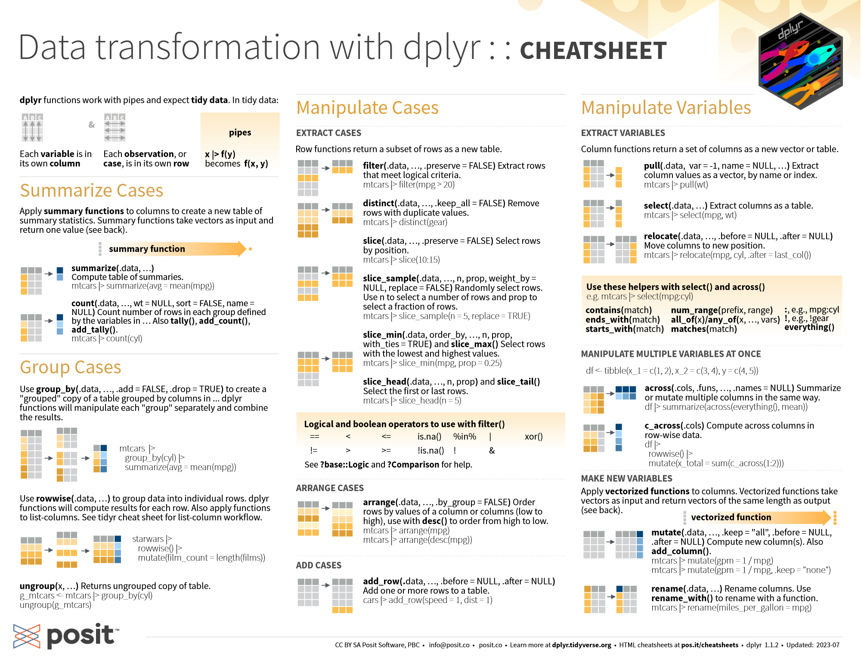
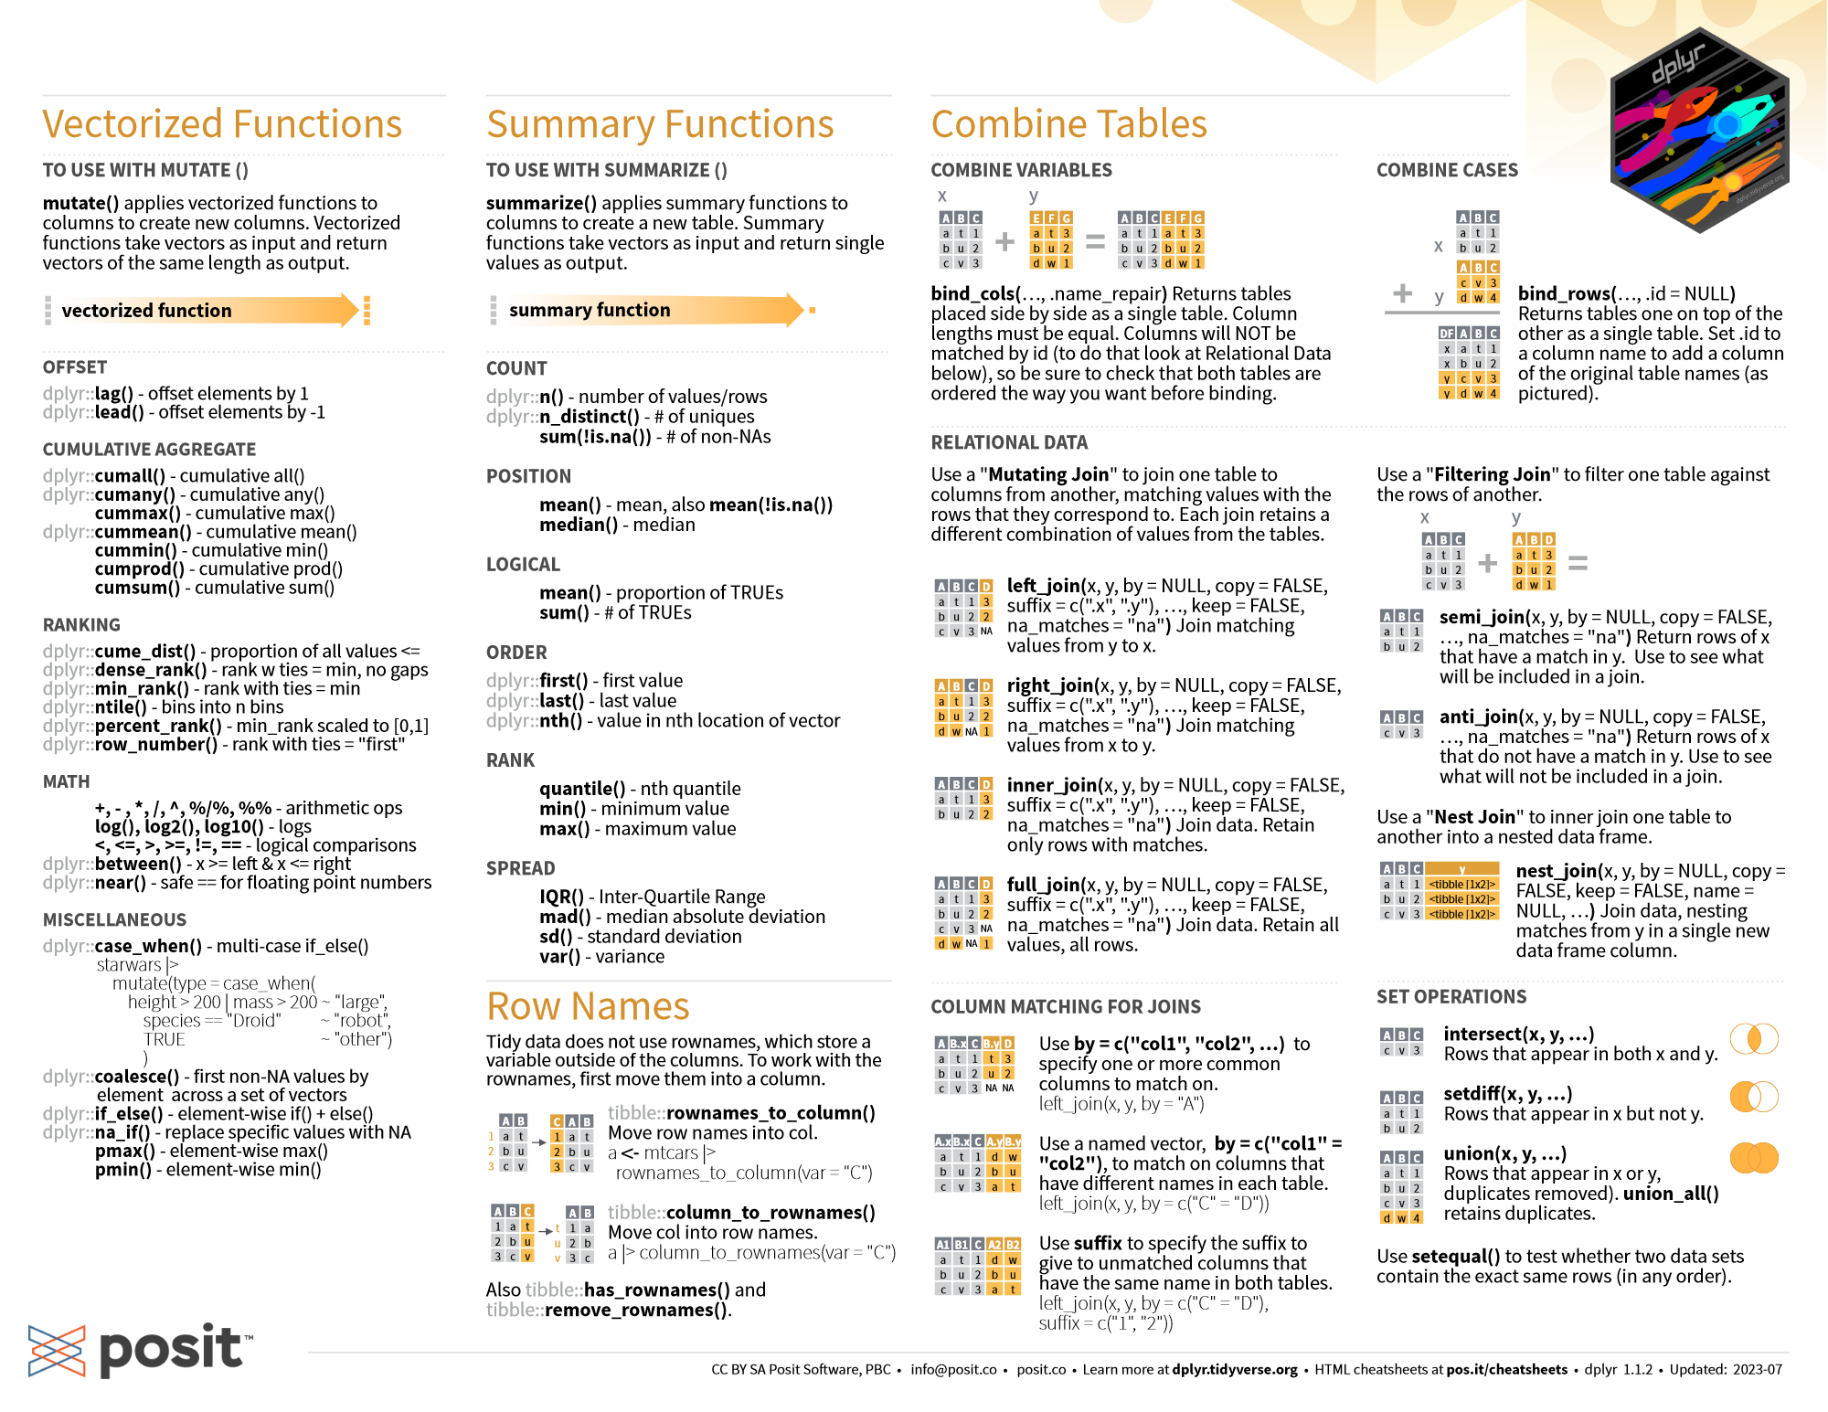
…and many more…
https://cran.r-project.org/web/packages/dplyr/vignettes/dplyr.html
https://www.tidyverse.org/

Slide 21
Some data cleanup strategies… It all starts with finding the problems!
Some helpful summary functions:
names() - prints column names of a data.frame, or names of a list
str() - prints the structure of an object
summary() - prints a summary specific to an object type
head() and tail() - prints the first (or last) six rows or elements
table() - creates a table of unique values
table() everything that can be tabled
Suggestion: table(xxx, useNA="ifany")
table(xxx, yyy, useNA="ifany")
plot() everything that can be plotted
This will print unique combinations

Slide 22
A few magical tricks from external packages…
For fixing text:
str_trim() removes beginning & ending spaces of a vector or column of text
str_squish() removes beginning & ending spaces, and also collapses inner whitespace
janitor::clean_names() cleans the names of a data.frame
snakecase::to_snake_case() standardizes all text to snake_case
snakecase::to_any_case() standardizes text to any case specified
Loaded with tidyverse

